Slide 1

Assignment -3
Submitted by: Jay Panchal
Student Id: 100960958

Slide 2


Agenda
Rational Statement
Key Insights from Pandas Profile Report
Optimized LDA & QDA Confusion Matrix / Classification Report
Optimized LDA & QDA Comparison
Recommendations for Mr. John Hughes

Slide 3

Rational Statement
This project focuses on predicting wheat varieties (Kama, Rosa, and Canadian) from the WheatData.csv dataset using Linear Discriminant Analysis (LDA) and Quadratic Discriminant Analysis (QDA). To improve the quality of the predictions, Synthetic Minority Over-sampling Technique (SMOTE) was used to balance the data. The performance of each model is evaluated through metrics like recall, precision, and F1-score, aiming to determine the most reliable model for accurately distinguishing between wheat types based on Mr. John Hughes' requirements."

Slide 4
Key Insights from Pandas Profile Report
Class Distribution Imbalance: The dataset presents a significant imbalance in the representation of the wheat varieties, with the 'Canadian' variety being notably underrepresented compared to 'Kama' and 'Rosa.' This kind of imbalance in the target variable can skew model predictions, as discriminant analysis methods may disproportionately favor the more frequent classes ('Kama' and 'Rosa'). Without proper handling, such as through resampling or using techniques like SMOTE (Synthetic Minority Over-sampling Technique), the model's ability to accurately predict the less frequent class ('Canadian') might be reduced, resulting in biased classification outcomes.
High Correlation Between Kernel Features: An interesting observation is the high positive correlation between 'Perimeter of Kernel' and 'Length of Kernel Groove.' A correlation coefficient close to 1 suggests that these features are linearly related. In the context of discriminant analysis models, such high correlations between features may introduce multicollinearity, where redundant information makes it harder for the models to distinguish between different wheat varieties. This could reduce model efficiency and interpretability. To address this, techniques such as feature reduction, like Principal Component Analysis (PCA), may need to be considered before model training.
Skewness in Data Distribution: Several features, such as 'Asymmetry Coefficient' and 'Compactness,' exhibit skewed distributions, deviating from the normal bell-shaped curve. Skewness in predictor variables can hinder the performance of linear models like LDA, which assume normally distributed data for effective classification. The skewness in these variables could indicate the presence of outliers or non-linear relationships in the data. To improve model accuracy, transformations such as logarithmic or square root adjustments could be applied to normalize these features and ensure they better fit the assumptions of the discriminant analysis methods.

Slide 5
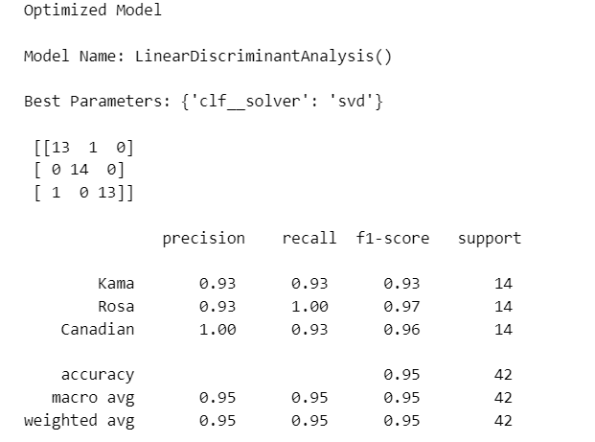
Confusion Matrix / Classification Report for Optimized LDA
Key Insights from the LDA Model:
Precision for 'Canadian':
The LDA model achieved perfect precision (1.00) for predicting the 'Canadian' class, which indicates that every time the model predicted 'Canadian,' it was correct. This shows the model’s excellent performance in minimizing false positives for this class.
Recall for 'Rosa':
The recall for the 'Rosa' class was 1.00, meaning that the LDA model correctly identified all instances of the 'Rosa' class in the dataset. This perfect recall shows that none of the 'Rosa' samples were misclassified, demonstrating the model’s high sensitivity to this class.
F1-Score for 'Kama':
The F1-Score for 'Kama' is 0.93, indicating a good balance between precision and recall for this class. While the model was effective at identifying 'Kama' samples, there was still a small margin of error, as reflected in the misclassification of one sample as 'Rosa.'

Slide 6
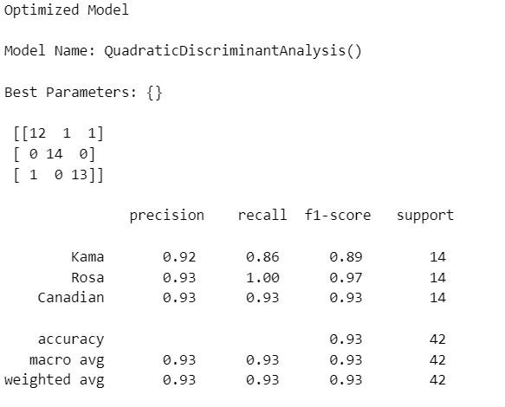
Confusion Matrix / Classification Report for Optimized QDA
Key Insights from the QDA Model:
Precision for 'Canadian':
The QDA model achieved a precision of 0.92 for predicting the 'Kama' class. This shows that while the model was fairly accurate in classifying 'Kama,' a small number of false positives occurred. This precision is slightly lower than LDA, suggesting the QDA model may struggle more with accurately identifying this class.
Recall for 'Rosa':
The recall for the 'Canadian' class in QDA was 0.93, indicating that the model successfully captured most of the 'Canadian' samples but did miss one. This suggests the QDA model’s performance in recalling 'Canadian' samples is consistent, although not perfect.
F1-Score for 'Kama':
The F1-Score for 'Rosa' in the QDA model was 0.97, which is highly similar to the LDA model’s performance. This high F1-score reflects a strong balance between precision and recall for the 'Rosa' class, suggesting that both models handle 'Rosa' predictions with similar efficiency.

Slide 7
Optimized LDA & QDA Comparison
Precision:
LDA Precision for 'Canadian' (1.00): The optimized LDA model achieved perfect precision for the 'Canadian' class, meaning every prediction for 'Canadian' was correct. This indicates that the LDA model was more efficient at avoiding false positives for this class.
QDA Precision for 'Kama' (0.92): The QDA model had a slightly lower precision for the 'Kama' class compared to LDA (0.93). This shows that LDA had a slight edge in avoiding false positives, especially for the 'Kama' class.
Insight: Overall, LDA demonstrated better precision for 'Canadian,' while QDA showed marginally lower precision for 'Kama.’
Recall:
LDA Recall for 'Rosa' (1.00): The LDA model achieved perfect recall for the 'Rosa' class, meaning that it correctly identified all 'Rosa' samples without missing any.
QDA Recall for 'Kama' (0.86): QDA had a lower recall for 'Kama,' correctly identifying 86% of the 'Kama' samples. This suggests that QDA missed a couple of 'Kama' samples, indicating a weaker performance in recall for this class compared to LDA.
Insight: LDA performed better in terms of recall, particularly for the 'Rosa' class, while QDA struggled more with recalling 'Kama' samples.
F1-Score:
LDA F1-Score for 'Canadian' (0.96): The F1-score for the 'Canadian' class in the LDA model was higher (0.96), showing a strong balance between precision and recall for this class.
QDA F1-Score for 'Kama' (0.89): The QDA model’s F1-score for 'Kama' was lower (0.89), indicating that QDA was less balanced between precision and recall for this class compared to LDA.
Insight: LDA exhibited a better balance of precision and recall for the 'Canadian' class, as reflected in the higher F1-score, while QDA performed slightly worse for 'Kama.'

Slide 8
Recommendations for Mr. John Hughes
1. Conduct Hyperparameter Tuning for QDA:
Recommendation: Although LDA had hyperparameters optimized, the QDA model was used with default parameters. Future analysis should include systematic hyperparameter tuning for QDA to explore potential improvements. Techniques like grid search or random search can be applied to test various configurations and enhance QDA’s predictive performance.
Explanation: Tuning parameters for QDA could help the model perform better, especially in handling minority classes, as certain configurations might help address overfitting or underfitting issues.
2. Explore Additional Classification Algorithms:
Recommendation: Given the close performance of LDA and QDA, it is recommended to explore more complex algorithms like Support Vector Machines (SVM) or Random Forests. These models are often more robust in capturing complex relationships within the dataset and may provide better accuracy and generalization across wheat varieties. This could lead to further improvements in predicting wheat types with more nuanced patterns.
Explanation: While LDA and QDA performed well, exploring advanced models could provide greater flexibility in handling non-linearity and interactions between features, which might not be well captured by linear models alone.

Slide 9

Thank you!

